Slide 1
Operating Systems Concepts
Week 4 & 5 – Processes, Two-State Process Model, Process creation, process termination, Five state process model, Process suspension

Slide 2
The OS manages execution of applications
Resources are made available to multiple applications
The processor is switched among multiple application
The processor and I/O devices can be used efficiently

Slide 3
What is a Process?
A program in execution
An instance of a program running on a computer
The entity that can be assigned to and executed on a processor
A unit of activity characterized by the execution of a sequence of instructions, a current state, and an associated set of system instructions
A process is comprised of:
Program code (possibly shared)
A set of data
A number of attributes describing the state of the process

Slide 4
Process Elements
While the process is running it has a number of elements including
Identifier
State
Priority
Program counter
Memory pointers
Context data
I/O status information
Accounting information

Slide 5
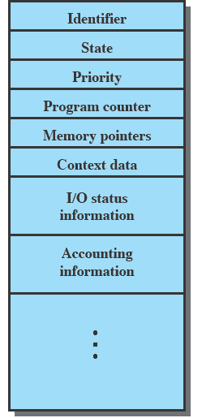
Process Control Block
A data structure that contains the process elements
Created and manage by the operating system
Allows support for multiple processes
contains sufficient information so that it is possible to interrupt a running process and later resume execution as if the interruption had not occurred.

Slide 6
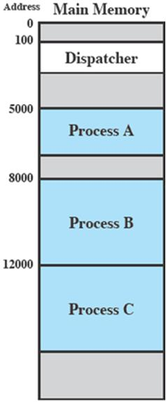
Process Execution
Consider three processes being executed
All are in memory (plus the dispatcher)
Dispatcher is a small program which switches the processor from one process to another

Slide 7
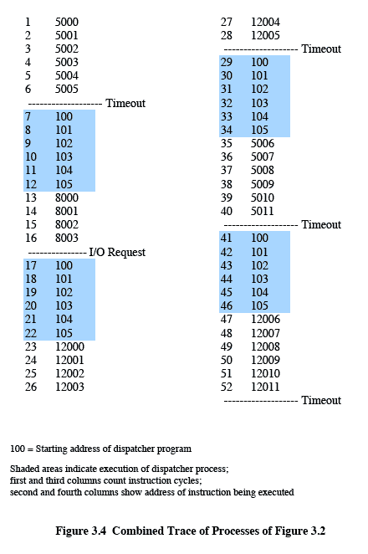
Process Execution (Animated Slide)
Timeout
I/O
Timeout
Timeout
Notes:
Animated slide
Scenario
The shaded areas represent code executed by the dispatcher.
The same sequence of instructions is executed by the dispatcher in each instance because the same functionality of the dispatcher is being executed.
We assume that the OS only allows a process to continue execution for a maximum of six instruction cycles, after which it is interrupted; this prevents any single process from monopolizing processor time.
Animate here
The first six instructions of process A are executed, followed by a time-out and the execution of some code in the dispatcher, which executes six instructions before turning control to process B2.
After four instructions are executed, process B requests an I/O action for which it must wait. Therefore, the processor stops executing process B and moves on, via the dispatcher, to process C.
After a time-out, the processor moves back to process A. When this process times out, process B is still waiting for the
I/O operation to complete, so the dispatcher moves on to process C again.

Slide 8
Two State Process Model
The operating system’s principal responsibility is controlling the execution of processes;
The first step in designing an OS to control processes is to describe the behaviour that we would like the processes to exhibit.
Two State Process Model is the simplest model to understand the behaviour of a process.

Slide 9
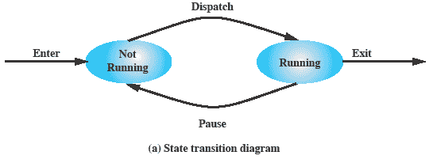
Two State Process Model Contd.
Process may be in one of two states
Running
Not-running

Slide 10
Contd.
OS creates a process block for each process
OS creates a process in not running state
The process waits for an opportunity for it to be executed
From time to time the process will be interrupted and the dispatcher portion of the OS will move other processes to be entertained by the processor.

Slide 11
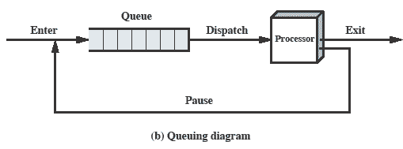
Queuing Diagram (Animated Slide)
Processes moved by the dispatcher of the OS to the CPU then back to the queue until the task is competed
Notes:
Animated slide The animation only shows one process moving.
There needs to be some structure so that the OS can keep track of the processes. This could be a simple queue which is managed by the dispatcher routine of the OS.

Slide 12
Contd.
Processes awaiting their execution are stored in a queue
Each entry in the queue represents a process
Process terminated is taken out of the queue
Processes that are interrupted and are in “Not Running” state are sent back to the queue.

Slide 13
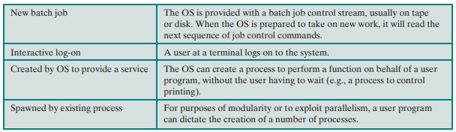
Process Creation

Slide 14
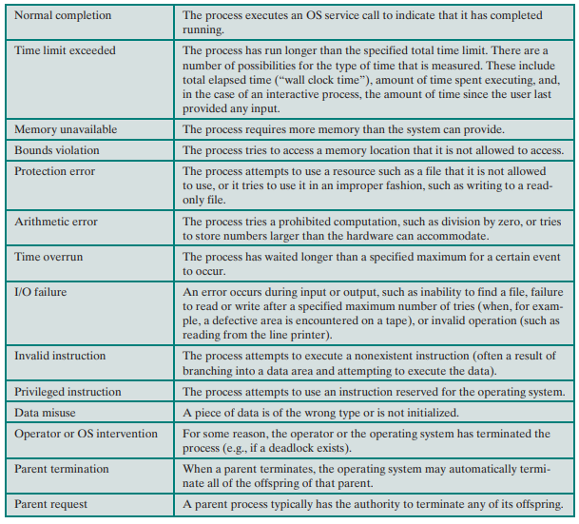
Process Termination

Slide 15
Five State Process Model
If all processes were always ready to execute, then the simple FIFO queuing model would suffice.
However, even with simple examples, this implementation is inadequate:
some processes in the Not Running state are ready to execute,
while others are blocked, waiting for an I/O operation to complete.
But due to the queue nature the ready to execute processes had to wait with the blocked processes
That caused delays and problems
To avoid that the “not running” state is split into two more states
Ready and Blocked
Two additional states are added that will prove to be useful; New and Exit

Slide 16
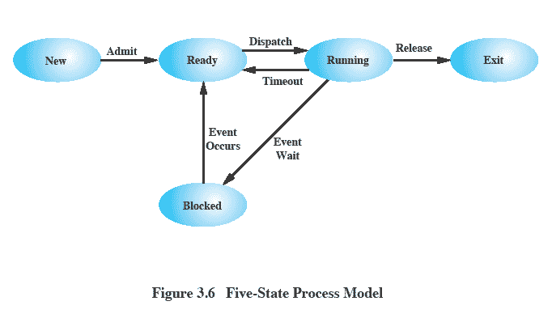
Contd.

Slide 17
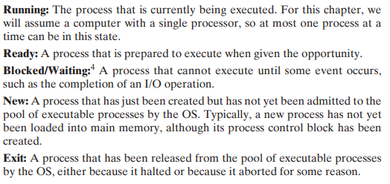
States Explained

Slide 18
New and Exit States Elaborated
Process New State
The OS performs some chores before creating a new process
It defines an identifier for that will help out to point out the process
Allocates some memory space and priority to the process
In simple words, creates the PCB (Process Control Block) of the process
Process Exit State
The OS sometimes stores some information before terminating the process
That information can be used by different programs like process files and accounting programs.

Slide 19
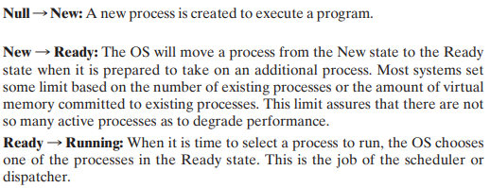
State Transitions

Slide 20
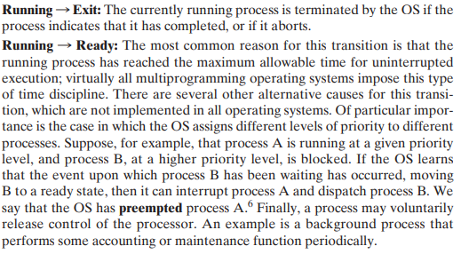
Contd.

Slide 21
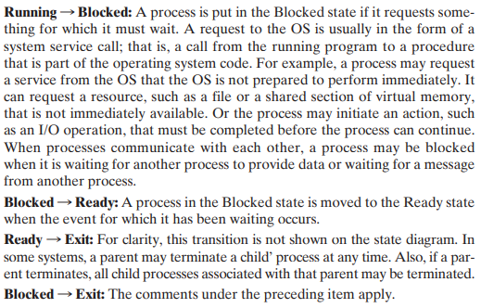
Contd.

Slide 22
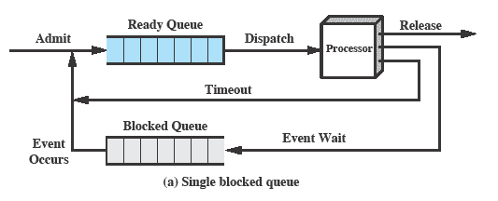
Five State Process Model Contd.

Slide 23
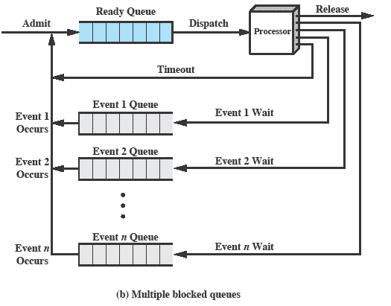
Contd.

Slide 24
Contd.
Simple Block Queue
Ready Processes go in the Ready Queue
Dispatcher sends the process to processor
Processes waiting for some event are sent to the blocked queue
Once the event occurs, process are sent into ready queue.
But when an event occurs the dispatcher would have to cycle through the entire block queue to see which process is waiting for the event.
This can cause huge overhead when their may be 100’s or 1000’s of processes
Multiple Block Queues
Bigger OS contains block queues for each type of event
Each event such as printer I/O request will have a separate block queue
Once an event occurs, process from the block queue waiting for that particular event is directly sent to the ready queue

Slide 25
But…
Processor is faster than I/O so all processes could be waiting for I/O
So, What to do?
Swap these processes to disk to free up more memory and use processor on more processes
Blocked state becomes suspend state when swapped to disk
Two new states
Blocked/Suspend
Ready/Suspend

Slide 26
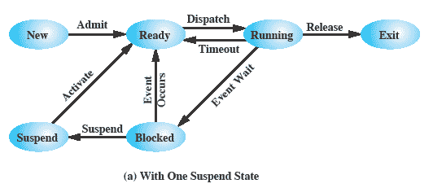
Solution
Again, the simple solution is to add a single state – but this only allows processes which are blocked to be swapped out.

Slide 27
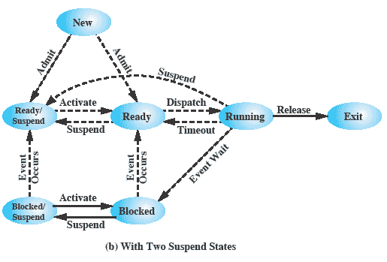
Contd.
What if all processes are ready but there is a higher priority process in the new state and the main memory is full. Hence, a better solution is to add two new states

Slide 28
Contd.
Two suspend states allow all processes which are not actually running to be swapped.
States Elaborated
Ready: The process is in main memory and available for execution.
Blocked: The process is in main memory and awaiting an event.
Blocked/Suspend: The process is in secondary memory and awaiting an event.
Ready/Suspend: The process is in secondary memory but is available for execution as soon as it is loaded into main memory.

Slide 29
State Transition Elaborated
Blocked → Blocked/Suspend: If there are no ready processes, then at least one blocked process is swapped out to make room for another process that is not blocked. This transition can be made even if there are ready processes available, if the OS determines that the currently running process or a ready process that it would like to dispatch requires more main memory to maintain adequate performance.
Blocked/Suspend → Ready/Suspend: A process in the Blocked/Suspend state is moved to the Ready/Suspend state when the event for which it has been waiting occurs.
Ready/Suspend S → Ready: When there are no ready processes in main memory, or if a suspended process has a higher priority, the OS will need to bring one in to continue execution.
Ready → Ready/Suspend: Normally, the OS would prefer to suspend a blocked process rather than a ready one, because the ready process can now be executed, whereas the blocked process is taking up main memory space and cannot be executed. However, it may be necessary to suspend a ready process if that is the only way to free up a sufficiently large block of main memory.

Slide 30
Contd.
New → Ready/Suspend and New →Ready: When a new process is created, it can either be added to the Ready queue or the Ready/Suspend queue. In either case, the OS must create a process control block and allocate an address space to the process. It might be preferable for the OS to perform these housekeeping duties at an early time, so that it can maintain a large pool of processes that are not blocked. With this strategy, there would often be insufficient room in main memory for a new process; hence the use of the (New → Ready/Suspend) transition.
Blocked/Suspend → Blocked: Inclusion of this transition may seem to be poor design. After all, if a process is not ready to execute and is not already in main memory, what is the point of bringing it in? But consider the following scenario:
A process terminates, freeing up some main memory.
There is a process in the (Blocked/Suspend) queue with a higher priority than any of the processes in the (Ready/Suspend) queue and
The OS has reason to believe that the blocking event for that process will occur soon.
Under these circumstances, it would seem reasonable to bring a blocked process into main memory in preference to a ready process.

Slide 31
Contd.
Running → Ready/Suspend: Normally, a running process is moved to the Ready state when its time allocation expires. If, however, the OS is pre-empting the process because a higher-priority process on the Blocked/Suspend queue has just become unblocked, the OS could move the running process directly to the (Ready/Suspend) queue and free some main memory.
Any State → Exit: Typically, a process terminates while it is running, either because it has completed or because of some fatal fault condition. However, in some operating systems, a process may be terminated by the process that created it or when the parent process is itself terminated. If this is allowed, then a process in any state can be moved to the Exit state.

Slide 32
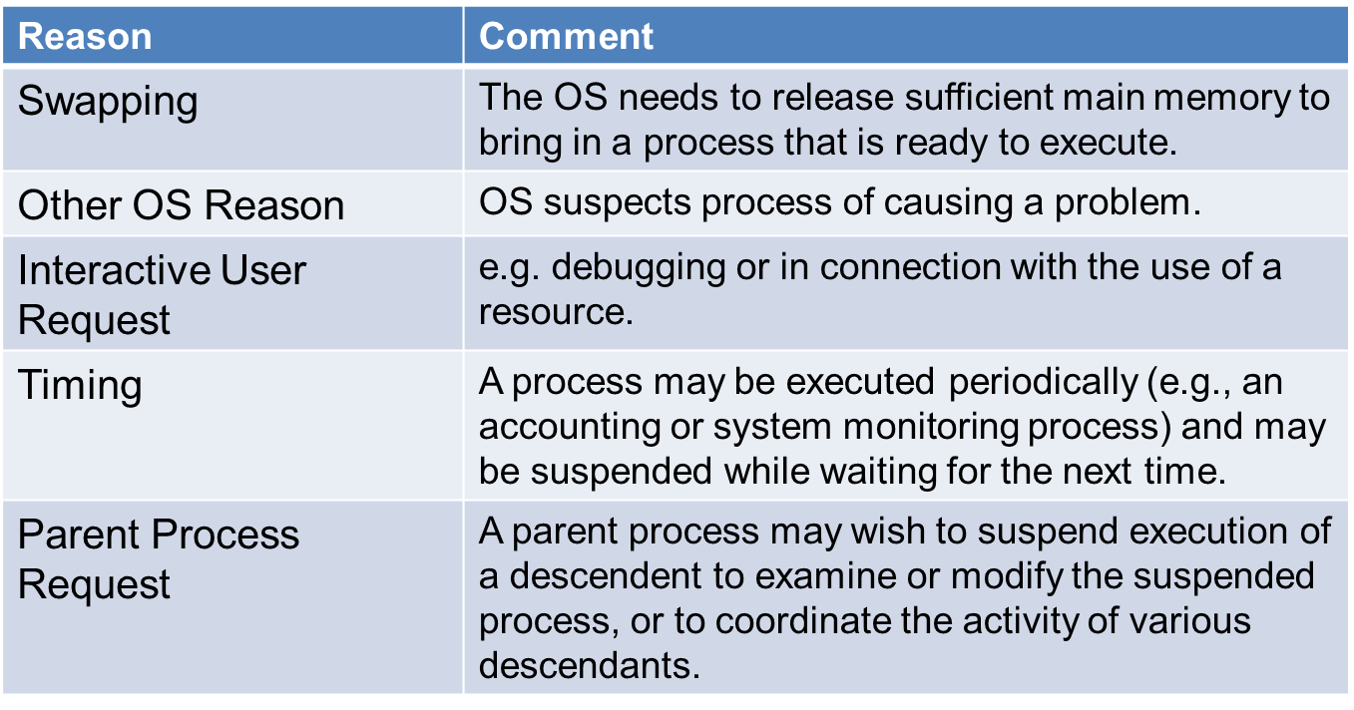
Reasons For Process Suspension

Slide 33
Thank You!

